Slide 1





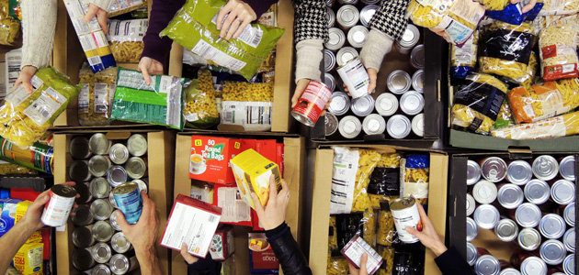
Whole School Overview – Spring 2
Whole School Dates - More details on each event to follow.
6th March 2026 - World Book Day activities - dressing up in pyjamas or as a book character
20th March 2026 - Red Nose Day - wear something red, taskmaster challenges and parent craft at 2.30pm.
9th March 2026 - Science Week – Curiosity: What’s Your Question? Investigations throughout the week and parent science activity in class at 2.30pm.
Reading Buddies
Each week classes partner up with a different year group to read in pairs. Parents are invited to come and join us at 2.30 and read with your child and their reading buddy.
Monday 2nd March –Y3 and Y6
Tuesday 3rd March – Y4 and Y1
Wednesday 4th March – Y2 and Y5
Weekly Events
Class Assemblies
Thank you to all parents have joined us for their child’s class assembly.
Tuesday 3rd March- Y6 Birch
Tuesday 10th March - Y1 Maple
Tuesday 17th March – Y2 Chestnut
Tuesday 24th March – Y3 Cherry
Coffee and cake - Tuesdays at 2.30- 3.15pm
Norfolk Hub - Mon 3.15pm and Weds 8.40am.
Trips and Visits
Y4 Oak swimming every Friday.
Future dates - Y2 Residential on 18th and 19th May.
Forest School
Y3 Holly will have forest school on either Wednesday or Thursday starting 11th Feb and finishing on Thursday 26th March

Slide 2
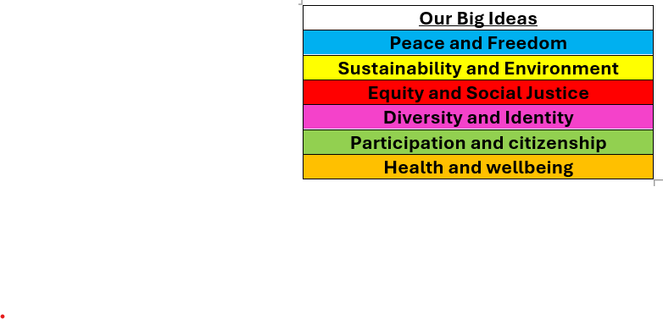

Whole School Curriculum Overview – Spring 2
At Norfolk, our curriculum is designed to provide our children with lots of new experiences so that they link their learning the world in which we live. We want to help them understand themselves and how to be good citizens. We will teach them about how past events have changed the world in which we live and how we can make a difference. Each half term we have a whole school Big Idea that we focus on in our assemblies and our learning in the classroom. This half term our Big Idea is Diversity and Identity.
Each week we have a different whole school question that we focus on in class and assemblies. These are this half terms questions:
What makes you, you?
What makes you special?
How are we similar and different from each other?
How have different cultures helped to make the UK an amazing place to live?
How can we be inclusive of all people especially people who are different to us?
Norfolk Navigators - We are curious
British Values - Mutual respect and tolerance of different faiths and beliefs
Each year group has a text linked to Peace and Freedom.

Slide 3


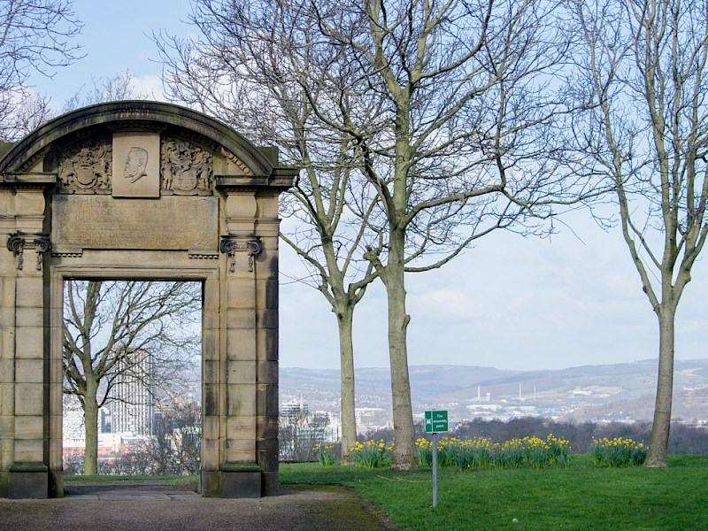
Reception FS2 – Spring 2
Curriculum Overview
Reading and writing
We will be reading The Big Dreaming, Here’s a Little Poem
And Mama Panya’s Pancakes. We will be writing labels, captions and simple sentences, using our ‘Fred Fingers’ to spell.
We will learn some tricky red words.
Geography – We will look at our local area and map out our route to Norfolk Park.
Maths
We will continue to look counting, ordinality and cardinality. We will focus on numbers beyond 5 and look at the composition of numbers 5-10.
PE
We will be doing anther dance unit in our PE lessons. We will learn about the importance of staying fit and healthy. We will continue to work on co-ordination, balance and agility.
Science: We will continue to learn about the season and weather patterns. We will investigate different clothes people wear around the world and why.
We will observe animals and the natural world.
Citizenship – RSHE and RE
RSHE: We will explore how are people different from me? And
How is life different for people living around the world?
RE: We will learn about The Easter Story and how people celebrate differently.

Slide 4
FS2 Reception - Spring 2
Home Learning Projects
These home learning projects are weekly, creative projects in addition to children’s reading. Children should read for a minimum of ten minutes every day. Please send photos and upload home learning to Class Dojo.
Project one: Kitchen helper
Handed in by: Friday 27th Feb
Details: Safely help a grown up in the kitchen. What could you spread, chop, grate and / or mash?
Project two: Animal research
Handed in by: Friday 6th March
Details: Can you go on a walk and observe animals in our local area. What do you notice? How are they the same and/or different?
Project three: Drawing
Handed in by: Friday 13th March
Details: Can you draw a picture of the four seasons? What will you draw for spring? Colour the drawing in with seasonal colours.
Project four: Gravity
Handed in by: Friday 20th March
Details: Go outside and experiment what happens with certain objects when you drop them. What happens with paper? What about a stone?
Project five: Lets get Physical!
Handed in by: Friday 27th March
Details: Using your learning from dance and gymnastics can you create a routine of the gymnastics moves and hold for a count of 16?
Project six: Easter Holidays
Handed in by: Monday 16th April
Details: Draw a picture of a special celebration. Add some labels and discuss with a grown up why it is special.

