Slide 1





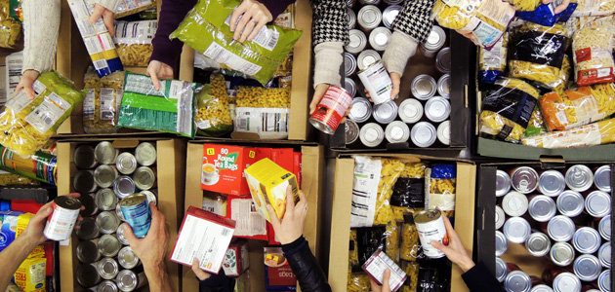
Whole School Overview – Spring 2
Whole School Dates - More details on each event to follow.
6th March 2026 - World Book Day activities - dressing up in pyjamas or as a book character
20th March 2026 - Red Nose Day - wear something red, taskmaster challenges and parent craft at 2.30pm.
9th March 2026 - Science Week – Curiosity: What’s Your Question? Investigations throughout the week and parent science activity in class at 2.30pm.
Reading Buddies
Each week classes partner up with a different year group to read in pairs. Parents are invited to come and join us at 2.30 and read with your child and their reading buddy.
Monday 2nd March –Y3 and Y6
Tuesday 3rd March – Y4 and Y1
Wednesday 4th March – Y2 and Y5
Weekly Events
Class Assemblies
Thank you to all parents have joined us for their child’s class assembly.
Tuesday 3rd March- Y6 Birch
Tuesday 10th March - Y1 Maple
Tuesday 17th March – Y2 Chestnut
Tuesday 24th March – Y3 Cherry
Coffee and cake - Tuesdays at 2.30- 3.15pm
Norfolk Hub - Mon 3.15pm and Weds 8.40am.
Trips and Visits
Y4 Oak swimming every Friday.
Future dates - Y2 Residential on 18th and 19th May.
Forest School
Y3 Holly will have forest school on either Wednesday or Thursday starting 11th Feb and finishing on Thursday 26th March

Slide 2
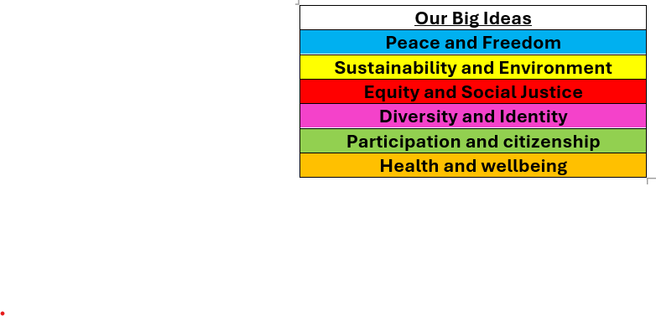

Whole School Curriculum Overview – Spring 2
At Norfolk, our curriculum is designed to provide our children with lots of new experiences so that they link their learning the world in which we live. We want to help them understand themselves and how to be good citizens. We will teach them about how past events have changed the world in which we live and how we can make a difference. Each half term we have a whole school Big Idea that we focus on in our assemblies and our learning in the classroom. This half term our Big Idea is Diversity and Identity.
Each week we have a different whole school question that we focus on in class and assemblies. These are this half terms questions:
What makes you, you?
What makes you special?
How are we similar and different from each other?
How have different cultures helped to make the UK an amazing place to live?
How can we be inclusive of all people especially people who are different to us?
Norfolk Navigators - We are curious
British Values - Mutual respect and tolerance of different faiths and beliefs
Each year group has a text linked to Peace and Freedom.

Slide 3


Year 3 – Spring 2
Curriculum Overview
Reading and writing
The Wild Robot
We will be writing a story about a big storm based on The Wild Robot. We will consider how Roz helps the animals on the island and what problems they face. We will also write instructions of how to survive on a wild island.
Maths
We will be learning about Fractions where we will compare and order fractions and count in fractions on a number line. We will also be learning about Mass and Capacity where we will compare capacity and measure mass.
Geography –
We will be learning about our local area and comparing our local area to surrounding areas. We will learn about urban and rural areas and human and physical features.
PE
Yoga and Fitness and Handball
We will work on our skills in PE to learn how to play handball. We will consider calming techniques in yoga and take particular focus on our breathing. We will also learn about our own fitness and build on our fitness skills.
Citizenship – RSHE and RE
RSHE: We will learn about what makes the world fair, friendships and families.
RE: We will learn about Christianity with a focus on Easter celebrations and ‘Good Friday’.

Slide 4
Year 5 - Spring 2
Home Learning Projects
These home learning projects are weekly, creative projects in addition to children's times tables, spellings and reading. Children should read for a minimum of ten minutes every day. Weekly times tables and spellings will be posted on Dojo.
Project one: Kitchen helper
Handed in by: Friday 27th Feb
Details: Can you help out at home and contribute to making a meal?
Project two: Local area research
Handed in by: Friday 6th March
Details: Can you go on a walk around your local area and make a note of all the human and physical features that you see?
Project three: Drawing
Handed in by: Friday 13th March
Details: Can you do a still life drawing inspired by Henri Matisse?
Project four: Family tree
Handed in by: Friday 20th March
Details: Can you create a family tree of who is in your family?
Project five: Lets get Physical!
Handed in by: Friday 27th March
Details: Can you teach an adult at home some yoga?
Project six: Easter Holidays
Handed in by: Monday 16th April
Details: Write a diary of what you have done in the Easter Holidays

