Slide 1





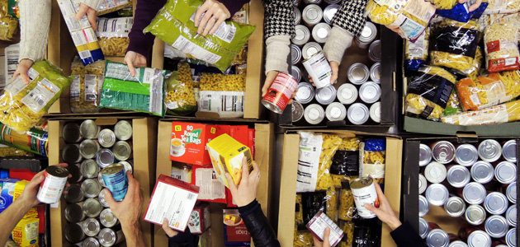
Whole School Overview – Spring 2
Whole School Dates - More details on each event to follow.
6th March 2026 - World Book Day activities - dressing up in pyjamas or as a book character
20th March 2026 - Red Nose Day - wear something red, taskmaster challenges and parent craft at 2.30pm.
9th March 2026 - Science Week – Curiosity: What’s Your Question? Investigations throughout the week and parent science activity in class at 2.30pm.
Reading Buddies
Each week classes partner up with a different year group to read in pairs. Parents are invited to come and join us at 2.30 and read with your child and their reading buddy.
Monday 2nd March –Y3 and Y6
Tuesday 3rd March – Y4 and Y1
Wednesday 4th March – Y2 and Y5
Weekly Events
Class Assemblies
Thank you to all parents have joined us for their child’s class assembly.
Tuesday 3rd March- Y6 Birch
Tuesday 10th March - Y1 Maple
Tuesday 17th March – Y2 Chestnut
Tuesday 24th March – Y3 Cherry
Coffee and cake - Tuesdays at 2.30- 3.15pm
Norfolk Hub - Mon 3.15pm and Weds 8.40am.
Trips and Visits
Y4 Oak swimming every Friday.
Future dates - Y2 Residential on 18th and 19th May.
Forest School
Y3 Holly will have forest school on either Wednesday or Thursday starting 11th Feb and finishing on Thursday 26th March

Slide 2


Whole School Curriculum Overview – Spring 2
At Norfolk, our curriculum is designed to provide our children with lots of new experiences so that they link their learning the world in which we live. We want to help them understand themselves and how to be good citizens. We will teach them about how past events have changed the world in which we live and how we can make a difference. Each half term we have a whole school Big Idea that we focus on in our assemblies and our learning in the classroom. This half term our Big Idea is Diversity and Identity.
Each week we have a different whole school question that we focus on in class and assemblies. These are this half terms questions:
What makes you, you?
What makes you special?
How are we similar and different from each other?
How have different cultures helped to make the UK an amazing place to live?
How can we be inclusive of all people especially people who are different to us?
Norfolk Navigators - We are curious
British Values - Mutual respect and tolerance of different faiths and beliefs
Each year group has a text linked to Peace and Freedom.

Slide 3


Year 4 – Spring 2
Curriculum Overview
Reading and writing
This half term we will be reading Percy Jackson and the Lightning Thief by Rick Riordan. We will also be looking at the book Journey and creating our own adventure stories about journeys that we would like to go on. Later in the term we are going to create holiday brochures about magical destinations.
Maths
In maths we will be learning about fractions and then beginning to learn all about decimals. We will also continue to practice our times table in preparation for the multiplication check.
Geography – How well do we know our European neighbours?
We will be looking at the country of Greece and comparing it to Sheffield, we will consider its physical geography and human geography.
PE
Y4 Oak will be starting their swimming lessons this half term.
Y4 Pine will be doing netball for their outdoor PE sessions.
Both classes will be doing Dodgeball during indoor PE.
Citizenship – RSHE and RE
RSHE: We will be answering the question, ‘How should we treat people who are different?’
RE: We will be answering the question, ‘What does it mean to be Hindu in Britain today?’
Science:
In science we will be learning about Sound. We will conduct investigations around how sound travels and how sound is received.

Slide 4
Year 4 - Spring 2
Home Learning Projects
These home learning projects are weekly, creative projects in addition to children's times tables, spellings and reading. Children should read for a minimum of ten minutes every day. Weekly times tables and spellings will be posted on Dojo.
Project one: Let’s get cooking!
Handed in by: Friday 27th Feb
Details: Make either some homemade cookies or biscuits and add your own flavourings to them!
Project two: European Neighbours
Handed in by: Friday 6th March
Details: Create a fact file on a famous or well known person from Greece.
Project three: Drawing
Handed in by: Friday 13th March
Details: Draw a picture using just pencil of the famous person you wrote about last week.
Project four: Sound
Handed in by: Friday 20th March
Details: Walk around your home and try and find the quietest place possible. Is anywhere completely quiet?
Project five: Lets get Physical!
Handed in by: Friday 27th March
Details: Practice throwing and catching a ball in the following ways, chest pass, shoulder pass, bounce pass.
Project six: Easter Holidays
Handed in by: Monday 16th April
Details: Research your favourite Greek God and draw a picture of them with words to describe them surrounding it.

