Slide 1





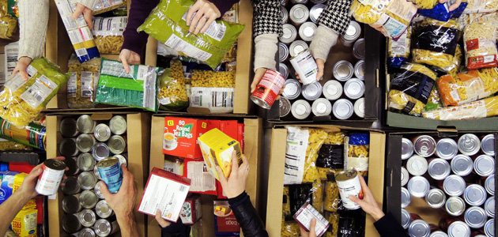
Whole School Overview – Spring 2
Whole School Dates - More details on each event to follow.
6th March 2026 - World Book Day activities - dressing up in pyjamas or as a book character
20th March 2026 - Red Nose Day - wear something red, taskmaster challenges and parent craft at 2.30pm.
9th March 2026 - Science Week – Curiosity: What’s Your Question? Investigations throughout the week and parent science activity in class at 2.30pm.
Reading Buddies
Each week classes partner up with a different year group to read in pairs. Parents are invited to come and join us at 2.30 and read with your child and their reading buddy.
Monday 2nd March –Y3 and Y6
Tuesday 3rd March – Y4 and Y1
Wednesday 4th March – Y2 and Y5
Weekly Events
Class Assemblies
Thank you to all parents have joined us for their child’s class assembly.
Tuesday 3rd March- Y6 Birch
Tuesday 10th March - Y1 Maple
Tuesday 17th March – Y2 Chestnut
Tuesday 24th March – Y3 Cherry
Coffee and cake - Tuesdays at 2.30- 3.15pm
Norfolk Hub - Mon 3.15pm and Weds 8.40am.
Trips and Visits
Y4 Oak swimming every Friday.
Future dates - Y2 Residential on 18th and 19th May.
Forest School
Y3 Holly will have forest school on either Wednesday or Thursday starting 11th Feb and finishing on Thursday 26th March

Slide 2
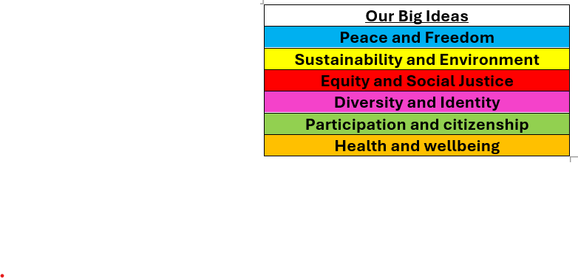

Whole School Curriculum Overview – Spring 2
At Norfolk, our curriculum is designed to provide our children with lots of new experiences so that they link their learning the world in which we live. We want to help them understand themselves and how to be good citizens. We will teach them about how past events have changed the world in which we live and how we can make a difference. Each half term we have a whole school Big Idea that we focus on in our assemblies and our learning in the classroom. This half term our Big Idea is Diversity and Identity.
Each week we have a different whole school question that we focus on in class and assemblies. These are this half terms questions:
What makes you, you?
What makes you special?
How are we similar and different from each other?
How have different cultures helped to make the UK an amazing place to live?
How can we be inclusive of all people especially people who are different to us?
Norfolk Navigators - We are curious
British Values - Mutual respect and tolerance of different faiths and beliefs
Each year group has a text linked to Peace and Freedom.

Slide 3


Year 5 – Spring 2
Curriculum Overview
Maths
In Maths, we will be learning about fractions, decimals and percentages. We will learn how to convert between them and understand their value. We will apply this knowledge to problem-solving activities. We will also learn how to calculate perimeter and area. The children will measure shapes and solve reasoning questions to explain their thinking.
Geography –
In Geography, we will be finding out where Brazil is in the world. We will locate it on a map and explore its physical and human features. We will compare South America with the UK. The children will learn about climate, population and landmarks.
Reading and writing
In Literacy and Reading, we will be studying The Explorer by Katherine Rundell. We will write an adventure narrative inspired by the text. The children will practise adding dialogue to build tension and show character feelings. We will focus on using descriptive language and varied sentence structures. The children will also write a non-fiction newspaper report about missing children linked to the story. We will work on using formal language and organising information clearly.
PE
In P.E., we will be developing teamwork and game skills through dodgeball and handball. The children will practise passing, defending and attacking. They will also work on communication and sportsmanship.
Citizenship – RSHE and RE
RSHE: we will discuss body image and the idea of a “perfect” body. We will learn how to stay fit and healthy and how to reduce the risk of illness.
RE: we will explore what Christians believe Jesus did to ‘save’ people. We will learn about the Christian belief in salvation and why Jesus’ death and resurrection are important to Christians.
Science
In Science, we will be learning about forces and how they affect movement. We will explore gravity, friction and air resistance. The children will take part in simple investigations to observe how forces work. They will learn how to record results and draw conclusions.

Slide 4
Year 5 - Spring 2
Home Learning Projects
These home learning projects are weekly, creative projects in addition to children's times tables, spellings and reading. Children should read for a minimum of ten minutes every day. Weekly times tables and spellings will be posted on Dojo.
Project one: Kitchen helper
Handed in by: Friday 28th Feb
Details: help your adults prepare a meal for the family. This could be helping with setting up the table or chopping the vegetables. Send us a picture!
Project two: Animal research
Handed in by: Friday 7th March
Details: Research one animal which lives in the Amazon Rainforest. What foods does it eat, what part of the animal kingdom does it belong to, or which part of the forest does it live?
Project three: Drawing
Handed in by: Friday 14th March
Details: Using pencils only, draw a picture of something you would find in the Amazon Rainforest. Think about shading and pencil pressure.
Project four: Gravity
Handed in by: Friday 21st March
Details: Investigation, drop bottles with different amounts of liquid to find out which one will hit the ground first. The results are surprising!
Project five: Lets get Physical!
Handed in by: Friday 28th March
Details: Using only things you can find in your home, create an obstacle course and time yourself completing it. Can you beaat your score?
Project six: Easter Holidays
Handed in by: Monday 14th April
Details: while outside, how many spring flowers can you find – remember not to pick them - take pictures and send them to us!

