Slide 1

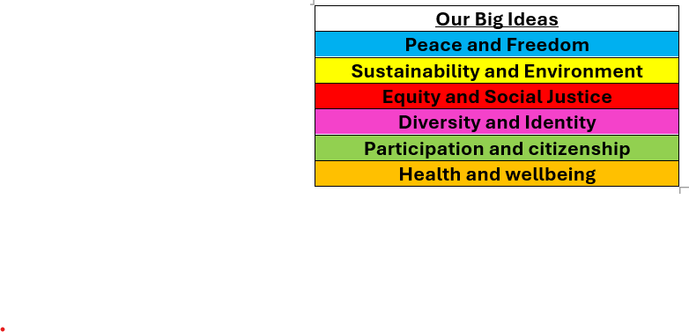

Whole School Curriculum Overview – Spring 1
At Norfolk, our curriculum is designed to provide our children with lots of new experiences so that they link their learning the world in which we live. We want to help them understand themselves and how to be good citizens. We will teach them about how past events have changed the world in which we live and how we can make a difference. Each half term we have a whole school Big Idea that we focus on in our assemblies and our learning in the classroom. This half term our Big Idea is Equity and Social Justice
Each week we have a different whole school question that we focus on in class and assemblies. These are this half terms questions:
Week 1 What is fairness?
Week 2 What does Equality mean?
Week 3 What is discrimination and how has it affected people in the past?
Week 4 Is the world always just?
Week 5 What does it mean to have equal opportunities?
Week 6 What can we do to stand up for justice?
Norfolk Navigators
We are resilient
We are inspired
British Values
Respect for the rule of law means that everyone in society is treated equally and fairly, and that everyone follows the same rules and laws.
Each year group has a text linked to Equity and Social Justice

Slide 2


Year 5 – Spring 1
Curriculum Overview
Reading and Writing
Reading: Cosmic by Frank Cottrell Boyce and Hidden
We will be working on improving our fluency and comprehension skills
Figures by Margot Lee Shetterly
Writing: Mars Transmition – We will be writing journal recount and a Cosmic story.
Maths
We will start by deepening our understanding of Fractions by learning to add and subtract mixed numbers. We will also strengthen our understanding of Multiplication & Division.
Please use times tables rockstars to support this knowledge.
History
We will be looking at the Space Race between the USA and USSR. We will learn more about significant individuals in the space race such as Katherine Johnson.
PE
Indoors, children will develop their strength, flexibility and balance through a range of gymnastics activities, focusing on control, movement and safe landings. They will learn to create and perform sequences, working both independently and with others. Outdoors, pupils will take part in tag rugby, developing passing, catching and teamwork skills while learning the rules and tactics of the game.
Science
We will be looking at Earth and Space. We will learn about the movement of the planets and how they orbit the Sun. We will investigate the Sun, Earth and Moon, including day and night and the phases of the Moon. We will also learn about gravity and how it affects objects on Earth.
Citizenship – RSHE and RE
We will be focusing on these questions:
What is prejudice?
What is the history of prejudice?
What should I do if I encounter prejudice?
Why do Hindus want to be good?

Slide 3
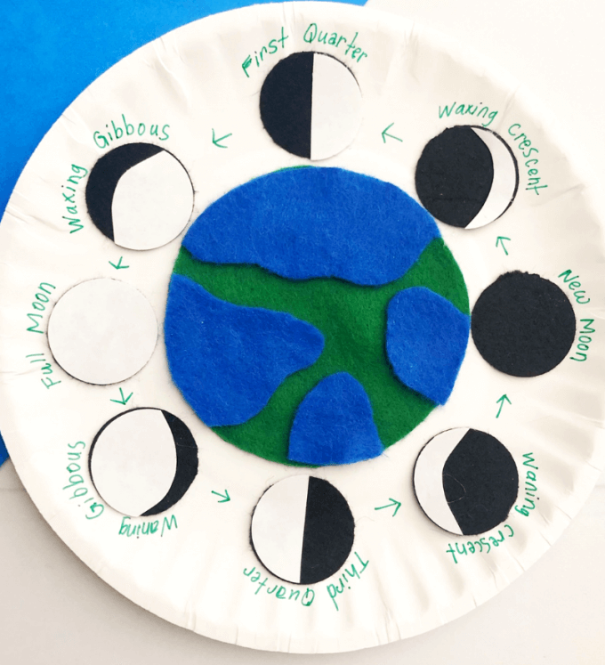
Year 5 – Spring 1
Home Learning Projects
These home learning projects are weekly, creative projects in addition to children's times tables, spellings and reading. Children should read for a minimum of ten minutes every day. Weekly times tables and spellings will be posted on Dojo.
Project one: Growing
Handed in by: Monday 12th January
Details: send us a picture of you planting something. Tomatoes, cauliflowers and sweet peas are great for January planting.
Project two: Moon phases
Handed in by: Monday 19th January
Details: can you create a phases of the moon paper plate display?
Project three: Space race!
Handed in by: Monday 26th January
Details: Research some famous space events and draw some pictures to match.
Project four: Stretch those legs!
Handed in by: Monday 2nd February Details: How many lunges can you do in one minute? Can you beat your score?
Project five: Make a bridge
Handed in by: Monday 9th February Details: Can you make a bridge strong enough for one of your cuddly toys? You can use any resources you can find.
Project six: Book journey
Handed in by: Monday 16th February Details: For each part of the book you read, draw a little picture to represent it. By the end you’ll have a beautiful poster to remind you of the book.

