Slide 1

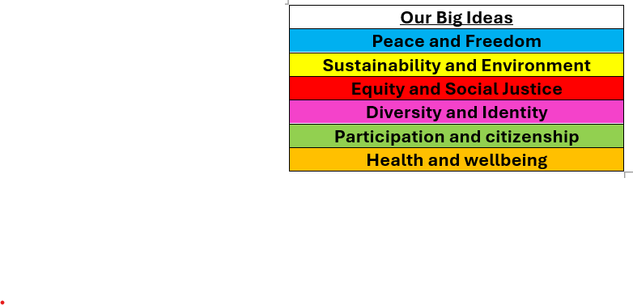

Whole School Curriculum Overview – Spring 1
At Norfolk, our curriculum is designed to provide our children with lots of new experiences so that they link their learning the world in which we live. We want to help them understand themselves and how to be good citizens. We will teach them about how past events have changed the world in which we live and how we can make a difference. Each half term we have a whole school Big Idea that we focus on in our assemblies and our learning in the classroom. This half term our Big Idea is Equity and Social Justice
Each week we have a different whole school question that we focus on in class and assemblies. These are this half terms questions:
Week 1 What is fairness?
Week 2 What does Equality mean?
Week 3 What is discrimination and how has it affected people in the past?
Week 4 Is the world always just?
Week 5 What does it mean to have equal opportunities?
Week 6 What can we do to stand up for justice?
Norfolk Navigators
We are resilient
We are inspired
British Values
Respect for the rule of law means that everyone in society is treated equally and fairly, and that everyone follows the same rules and laws.
Each year group has a text linked to Equity and Social Justice

Slide 2


Year 1 – Spring 1
Curriculum Overview
Reading and writing
We will be:
Reading the book Coming to England and working on our sentence structure. We will be exploring non-fiction texts such as ‘Bold women in Black History, which will tie in nicely with our ‘Big Question’ around influential people
Maths
We will be:
Looking at numbers to 20 focussing on place value, addition and subtraction. We will be doing lots of practical work and developing our oracy skills by talking about our learning.
History
We will be:
Exploring significant individuals such as Martin Luther King and Floella Benjamin. We will be looking at why these people were significant
PE
We will be:
Doing gymnastics inside and Ball skills outside.
Science
We will be:
Exploring different animal groups. We will be sorting and classifying animals according to their different features.
Citizenship – RSHE and RE
We will be:
Looking at what makes us a good friend and who our friends are. This will open up discussions around being kind, as well as talks around what a friendship looks like and how to be a good friend.

Slide 3
Year 1 – Spring 1
Home Learning Projects
These home learning projects are weekly, creative projects in addition to children's times tables, spellings and reading. Children should read for a minimum of ten minutes every day. Weekly times tables and spellings will be posted on Dojo.
Project one:
Handed in by: Monday 12th January
Details:
Can you draw a picture to show all the different things that remind you of Winter? Can you write some labels too?
Project two:
Handed in by: Monday 19t^{h} January
Details:
Can you draw a picture of your favourite animal? Can you describe the animal? What animal group does it belong to?
Project three:
Handed in by: Monday 26th January
Details:
Can you choose a number between 10 and 20 and show all the different ways of making it?
Project four:
Handed in by: Monday 2nd February Details:
Can you read a story and draw a picture of your favourite part with a sentence explain what is happening?
Project five:
Handed in by: Monday 9th February Details:
Can you draw a picture od Floella Benjamin and write a sentence to explain why she was so important?
Project six:
Handed in by: Monday 16th February Details:
Can you draw a picture of yourself and write 5 things that make you a great friend?

