Slide 1





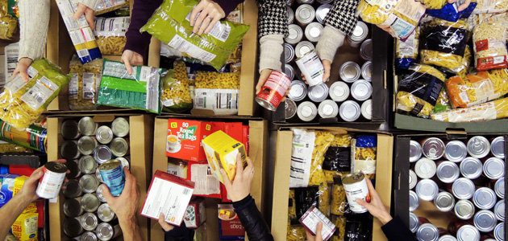
Whole School Overview – Spring 2
Whole School Dates - More details on each event to follow.
6th March 2026 - World Book Day activities - dressing up in pyjamas or as a book character
20th March 2026 - Red Nose Day - wear something red, taskmaster challenges and parent craft at 2.30pm.
9th March 2026 - Science Week – Curiosity: What’s Your Question? Investigations throughout the week and parent science activity in class at 2.30pm.
Reading Buddies
Each week classes partner up with a different year group to read in pairs. Parents are invited to come and join us at 2.30 and read with your child and their reading buddy.
Monday 2nd March –Y3 and Y6
Tuesday 3rd March – Y4 and Y1
Wednesday 4th March – Y2 and Y5
Weekly Events
Class Assemblies
Thank you to all parents have joined us for their child’s class assembly.
Tuesday 3rd March- Y6 Birch
Tuesday 10th March - Y1 Maple
Tuesday 17th March – Y2 Chestnut
Tuesday 24th March – Y3 Cherry
Coffee and cake - Tuesdays at 2.30- 3.15pm
Norfolk Hub - Mon 3.15pm and Weds 8.40am.
Trips and Visits
Y4 Oak swimming every Friday.
Future dates - Y2 Residential on 18th and 19th May.
Forest School
Y3 Holly will have forest school on either Wednesday or Thursday starting 11th Feb and finishing on Thursday 26th March

Slide 2
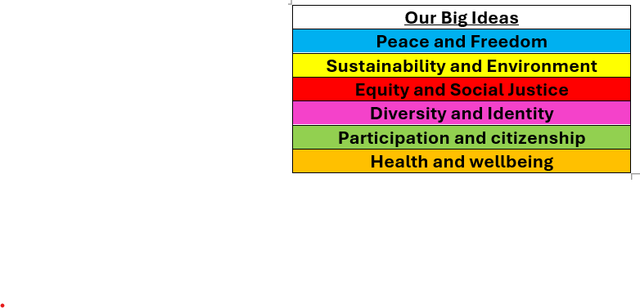

Whole School Curriculum Overview – Spring 2
At Norfolk, our curriculum is designed to provide our children with lots of new experiences so that they link their learning the world in which we live. We want to help them understand themselves and how to be good citizens. We will teach them about how past events have changed the world in which we live and how we can make a difference. Each half term we have a whole school Big Idea that we focus on in our assemblies and our learning in the classroom. This half term our Big Idea is Diversity and Identity.
Each week we have a different whole school question that we focus on in class and assemblies. These are this half terms questions:
What makes you, you?
What makes you special?
How are we similar and different from each other?
How have different cultures helped to make the UK an amazing place to live?
How can we be inclusive of all people especially people who are different to us?
Norfolk Navigators - We are curious
British Values - Mutual respect and tolerance of different faiths and beliefs
Each year group has a text linked to Diversity and Identity.

Slide 3


Year 1 – Spring 2
Curriculum Overview
Reading and writing
We will be reading the book Rapunzel and writing descriptive sentences about the story.
We will also be writing a non-fiction piece about living in the UK.
Maths
In maths we will be looking at Place Value within 50, Length & Height and Mass & Volume.
Geography – In geography we will be learning countries and capital cities in the UK. We will then look at seaside towns in the UK, talking about the features you might see.
Art – In art we will be practising our drawing skills and looking at different artists.
PE
Our indoor PE will be doing dance.
Our outdoor PE will be invasion games.
Science
In science we will be learning about plants. We will look at different types of plants and what they need to survive.
Citizenship – RSHE and RE
In citizenship we will be learning about families and how they are not all the same.
In RE we will be learning about Christianity and the Easter story.

Slide 4
Year 1 - Spring 2
Home Learning Projects
These home learning projects are weekly, creative projects in addition to children's times tables, spellings and reading. Children should read for a minimum of ten minutes every day. Weekly times tables and spellings will be posted on Dojo.
Pr
Project one:
Handed in by: Monday 2nd March
Details: Draw a picture of Rapunzel and write a sentence about her.
Project two:
Handed in by: Monday 9th March
Details: Write some numbers and partition them into tens and ones.
Project three:
Handed in by: Monday 16th March
Details: Draw a picture of a plant and label the parts.
Project four:
Handed in by: Monday 23rd March
Details: Draw a picture of who is in your family and label it.
Project five:
Handed in by: Thursday 27th March
Details: Draw and label things you would see at the seaside.
Project six: Easter Holidays
Handed in by: Monday 16t^{h} April
Details: Make your own easter bonnet.

