Slide 1

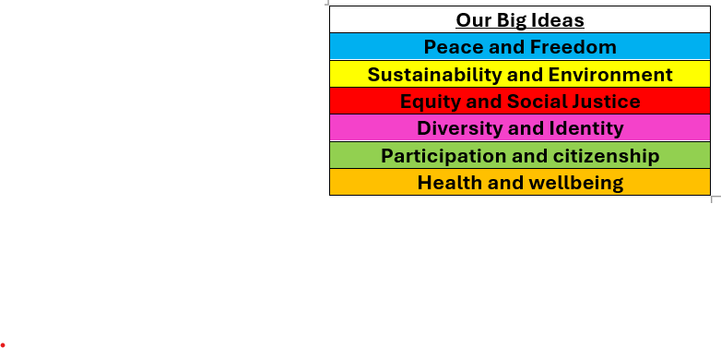

Whole School Curriculum Overview – Spring 1
At Norfolk, our curriculum is designed to provide our children with lots of new experiences so that they link their learning the world in which we live. We want to help them understand themselves and how to be good citizens. We will teach them about how past events have changed the world in which we live and how we can make a difference. Each half term we have a whole school Big Idea that we focus on in our assemblies and our learning in the classroom. This half term our Big Idea is Equity and Social Justice
Each week we have a different whole school question that we focus on in class and assemblies. These are this half terms questions:
Week 1 What is fairness?
Week 2 What does Equality mean?
Week 3 What is discrimination and how has it affected people in the past?
Week 4 Is the world always just?
Week 5 What does it mean to have equal opportunities?
Week 6 What can we do to stand up for justice?
Norfolk Navigators
We are resilient
We are inspired
British Values
Respect for the rule of law means that everyone in society is treated equally and fairly, and that everyone follows the same rules and laws.
Each year group has a text linked to Equity and Social Justice

Slide 2





FS2 Reception – Spring 1
Curriculum Overview
Reading and writing
We will be looking at Fairy Tales, Peace at Last and The Dot. We will be writing labels and captions using our ‘Fred Fingers’ to help us with spellings.
Maths
We will be looking at ordinality and composition. We will start to look at numbers beyond 5. We will also look at mass and capacity.
History
We will be discussing events of the past such as special events and celebrations.
Science
We will be investigating and observing changes around us. We will focus on seasons and explore materials.
PE
We will be doing gymnastics. We will be learning static poses, using our core strength and practising balance skills.
Once upon a time….
Art
We will be learning about Kandinsky and mixing colours. We will create a collaborative piece of art.
Citizenship – RSHE and RE
We will be looking at kindness and equity. We will listen to others' beliefs.

Slide 3
FS2 Reception – Spring 1
Home Learning Projects
These home learning projects are weekly, creative projects. Children should read for a minimum of ten minutes every day. Please send work / photos to the class teacher via Dojo.
Project two:
Handed in by: Monday 26th January
Details: Can you retell the Peace at Last story? Draw a picture and add a label. Don’t forget to use your Fred fingers for spellings!
Project three:
Handed in by: Monday 26th January
Details: Can you draw a picture of a celebration you can remember from your past? Add some labels if you can.
Project four:
Handed in by: Monday 2nd February Details: Can you practise the static movements we have learnt in PE? Show your grown ups Tuck, Pike, Straight, Straddle and Star poses.
Project five:
Handed in by: Monday 9th February Details: Find some ice(from outside or the freezer) and see how long it takes to melt. Investigate melting and how ice is created. How can you speed up or slow down the process of melting?

